Slide 1
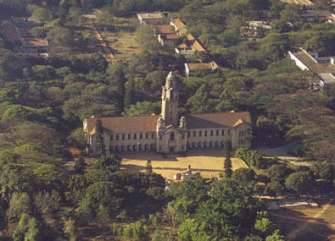
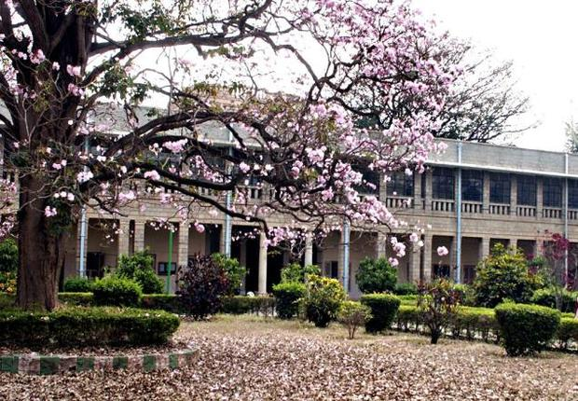
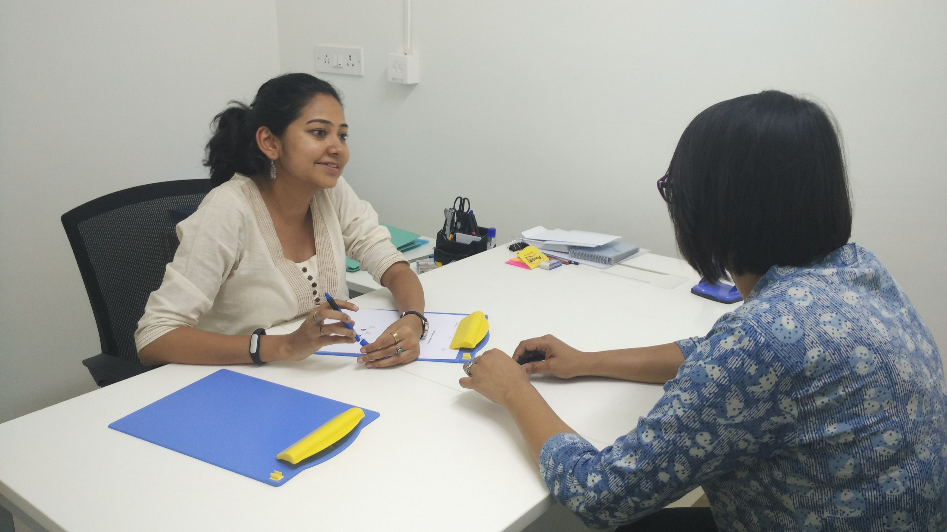
INDIA - ADNI
Dr Naren Rao
Centre for Neuroscience, Indian Institute of Science
& National Institute of Mental Health and Neurosciences

Slide 2
Tata Longitudinal study - India
Alzheimer’s disease: : Understanding mechanisms for early diagnosis and treatment
At Centre for Neuroscience, Indian Institute of Science, Bangalore
Funded by Tata trust, a private philanthropy
A longitudinal study involving three groups Cognitively normal (CN), Mild cognitive impairment (MCI), Alzheimer’s Disease (AD)
Age for inclusion - >50 years
Baseline visit and annual follow-up
2 Centres – Bangalore and Hyderabad (n=300+300)

Slide 3
Inclusion criteria
CN | MCI | AD
Subject must be free of memory complaints, verified by a study partner | Subject must have a subjective memory concern as reported by subject, study partner | Subject must have a subjective memory concern as reported by subject, study partner
Hindi Mental Status Examination (HMSE) 24 – 31 | HMSE 24-31 | HMSE <24
Clinical Dementia Rating = 0 | Clinical Dementia Rating = 0.5 | Clinical Dementia Rating = 1.0
Cognitively normal, based on an absence of significant impairment in cognitive functions or activities of daily living | General cognition and functional performance sufficiently preserved such that a diagnosis of Alzheimer’s disease cannot be made | NINCDS/ADRDA criteria for probable AD

Slide 4
Inclusion criteria
Age >50 years (ADNI – 55)
Study partner is available who has frequent contact with the subject
Visual and auditory acuity adequate for neuropsychological testing.
Good general health with no diseases expected to interfere with the study

Slide 5
Exclusion criteria
Any significant neurological illness
Screening/baseline MRI scan with evidence of infection, large vessel infarction, or other focal lesions
History of schizophrenia, Bipolar disorder or substance abuse/dependence (DSM-IV)
Any significant systemic illness or unstable medical condition which could lead to difficulty complying with the protocol

Slide 6
 | Baseline | Annual follow up
Explain study & obtain consent | X
Demographics, Screening criteria | X
Clinical examination | X | X
Vital signs | X | X
Cognitive tests | X | X
Lab investigations | X | X
MRI | X | X
FDG - PET | X | X
CSF collection by Lumbar puncture | X

Slide 7
Schedule of events
Schedule of Events
Telephonic screening
Cognitive assessment
Blood investigation
MRI
PET
(18F-FDG)
Discharge- Follow up
Clinical assessment

Slide 8
Recruitment (Bangalore site – 10 months)
HV | Cognitive and Clinical session | Clinical Investigation | MRI | PET
India study | 34 | 31 | 30 | 16
Upon ADNI age criteria | 24 | 24 | 22 | 11
MCI | Cognitive and Clinical session | Clinical Investigation | MRI | PET
India study | 8 | 8 | 7 | 3
Upon ADNI age criteria | 6 | 6 | 5 | 2
AD | Cognitive and Clinical session | Clinical Investigation | MRI | PET
ADNI age criteria | 1 | 1 | 1 | 1

Slide 9
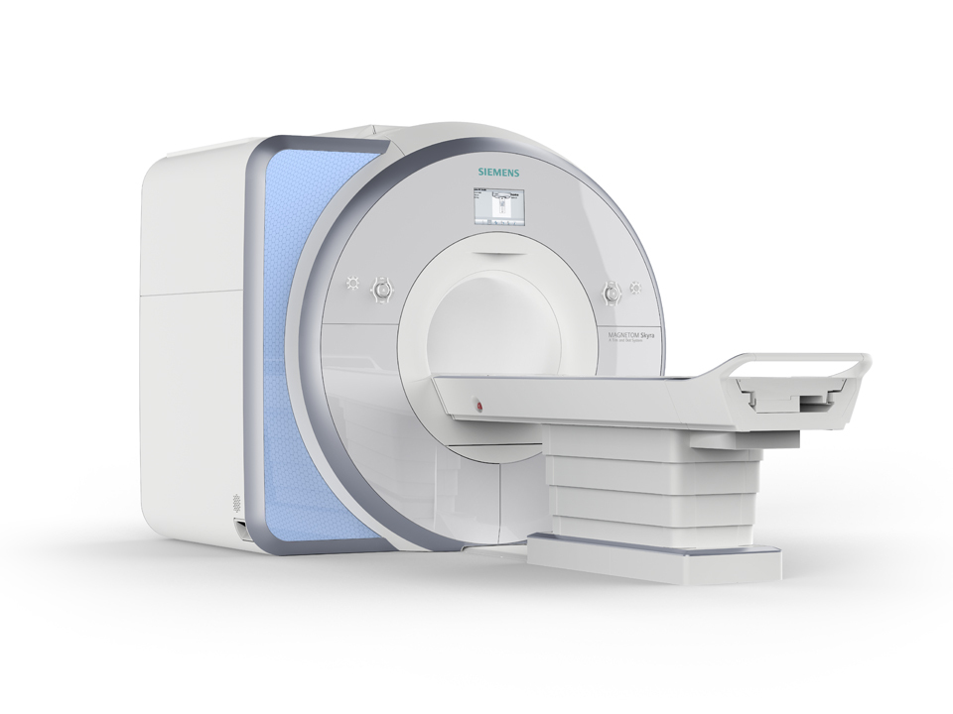
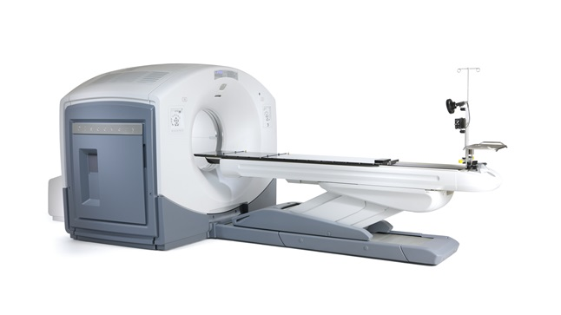
MRI
Siemens MAGNETOM Skyra 3Tesla
Software version: D13
Coil: Head/Neck 20
PET/CT
GE Discovery 690
Purchase of new research dedicated scanner is in process – Timeline – 6 months

Slide 10
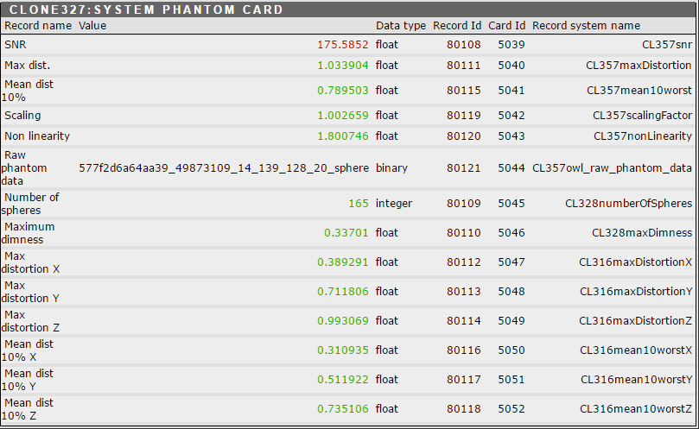
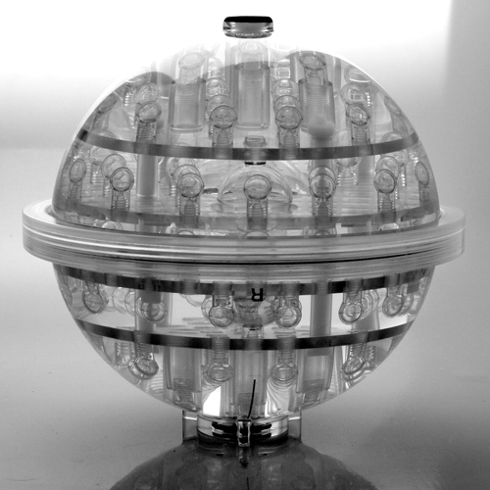
Image Quality check
Magphan EMR051

Slide 11
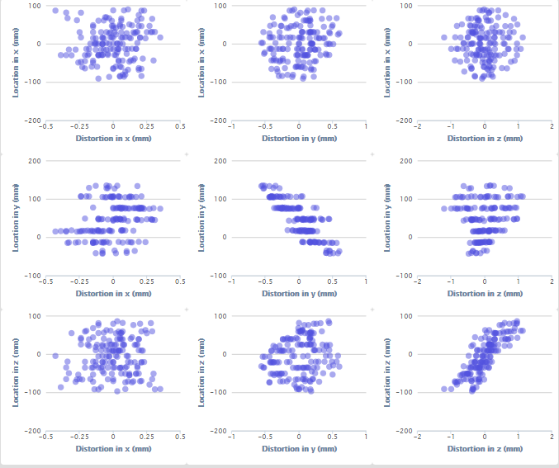
Notes:
Will shortly send a document with explanations

Slide 12
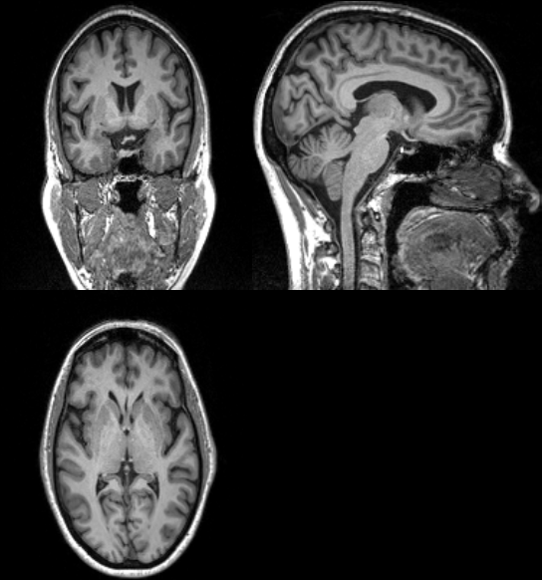
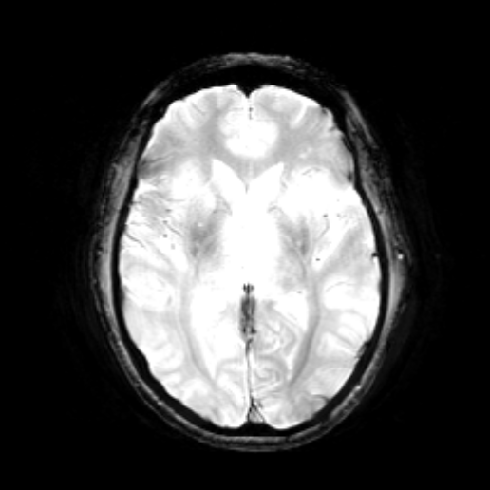
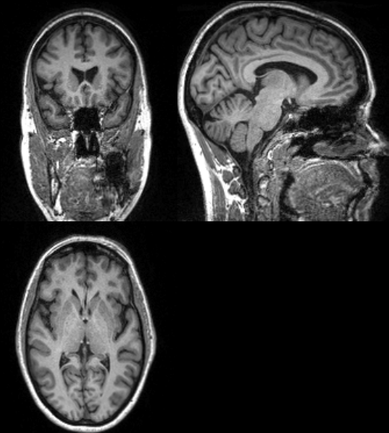
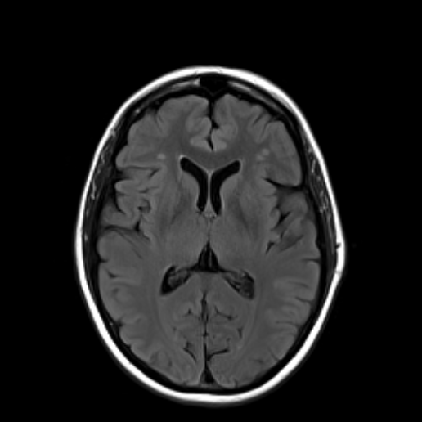
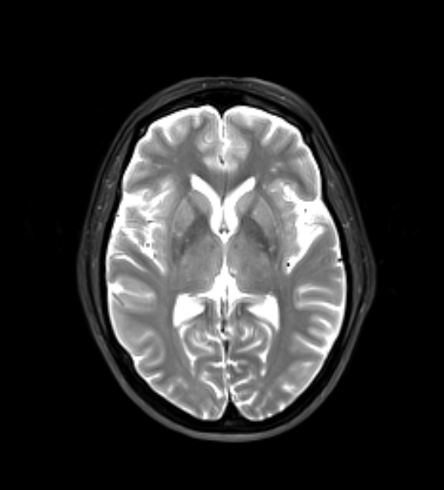
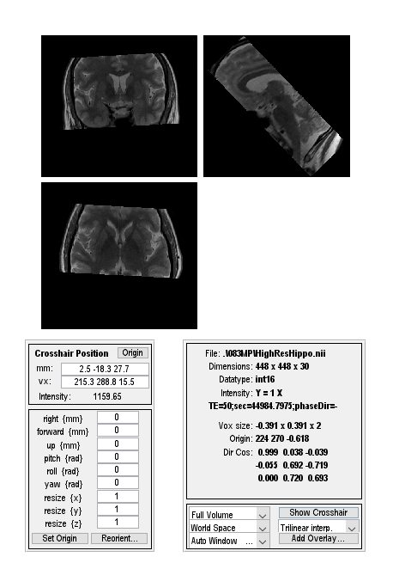
Parameters
Sequence name: T1
TA: 9:14
TR: 2300
TE: 2.98
Voxel size: 1x1x 1.2 mm
Flip angle: 9 deg
Parameters
Sequence name:T2 star
TA:4:11
TR:650 ms
TE:20 ms
Voxel Size: 0.9x0.9x4mm
Flip Angle:20 deg
Parameters
Sequence name: T1 (Grappa)
TA: 9:14
TR: 2300
TE: 2.98
Voxel size: 1x1x 1.2 mm
Flip angle: 9 deg
Parameters
Sequence name:T2flair
TA:4:05
TR:9000 ms
TE:91 ms
Voxel Size:0.9x0.9x5mm
Flip angle: 150 deg
Parameters
Sequence name:T2 with Fat Sat
TA: 3:26
TR: 4000.0ms
TE: 78.0ms
Voxel Size: 0.9x0.9x4.0mm
Flip angle: 150 deg
Parameters
Sequence name: High Res Hippo
TA: 8:11
TR:8020
TE:50 ms
Voxel Size:0.4x0.4x2 mm
Flip Angle: 122 deg

Slide 13
MRI acquisition differences
ADNI- MRI | India-MRI | Reason
Skyra 3T scanner D11 | Skyra 3T scanner D13 | Difference in software version
T1, T2, High Res Hippo | T1, T2, High Res Hippo | Similar to ADNI 2
Arterial Spin Labeling | Not acquired | Scanner license restriction – commercial license not available
Resting State | Parameters differ | Scanner license restriction - options are not available
Rest of the parameters are in compliance with ADNI 2 protocol

Slide 14
Parameter | ADNI- PET | INDIA - PET | Reason
Reconstruction | Reconstruction: Iterative (3D) 4 iterations; 21 subsets | Reconstruction: Iterative (3D) 4 iterations; 24 subsets | Scanner restriction – cannot decrease below 24 subsets
Grid | 128 x128 | 192 x 192 | Scanner restriction - Cannot be decreased to 128X128
Slice thickness | 3.27mm | 3.75mm | Scanner restriction - Cannot be decreased below 3.75
Smoothing filter | NONE | Heavy | Option ‘None’ not available
Rest of the parameters are in compliance with ADNI 2 protocol

Slide 15
Cognitive assessments
 | ADNI | Alternative - India
Screening | MMSE | HMSE
 | Logical Memory I | Adapted to Indian population (NIMHANS battery)
 | Logical Memory II | Adapted to Indian population (NIMHANS battery)

Slide 16
Cognitive assessments
ADNI | India
Clock Drawing | Yes
Category Fluency(animals) | Yes (Indian languages)
Trails A &B | Yes (Indian adaptation)
Boston Naming Test (30 items) | Yes (Indian adaptation)
Rey Auditory Verbal learning test | Yes (Translated to Indian lnguages)
Logical memory – immediate recall | Yes (Indian adaptation)
Logical memory – delayed recall | Yes (Indian adaptation)

Slide 17
Cognitive assessments
ADNI | India
American National Adult Reading Test (ANART) | No
Alzheimer’s Disease Assessment Scale (ADAS)-COg | No
Everyday Cognition-Participant and partner report | No
Montreal Cognitive Assessment | No
 | Addenbrooke’s Cognitive Examination -III
 | Digit Symbol substitution
 | Digit span
 | Go-No-Go
 | Stroop test
 | Pictures of Facial affect
 | Modified Taylor Complex Figure test

Slide 18
Global Functional and Behavioral Assessments
ADNI | India | Alternative
CDR | Yes
GDS | Yes | Hamilton Depression Rating Scale
NPI | Yes
ADL | Yes | Instrumental activities of daily Living (Applicable to Indian population)
Modified Hachinski | Yes
Everyday Cognition | No

Slide 19
Unique challenges
Multilinguistic cohort
Interview and cognitive test done in primary language (instruments translated to Kannada, Telugu, Tamil, Hindi in addition to English)
Though not the first language many CN prefer English as the language of assessment
Vegetarian diet – common in India. Vitamin B12 deficiency with preserved cognitive functions is prevalent in CN. Homocysteine levels are not proportionately changed.
Elevated TSH is common with intact cognition
Illiterate population (Education level = 0). Cognitive tests and instruments have been modified and validated
White matter hyper-intensities are common in elderly population with intact cognitive functions

Slide 20
Notes:
Homocysteine is high in them – 29, 38 etc
However even in those with normal Vitamin B12 – homocysteine is high

Slide 21
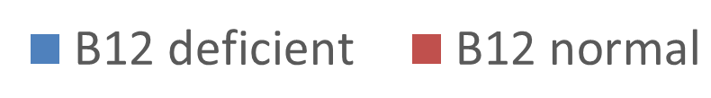
Mean B12 deficient vs Normal
Notes:
B12 deficient n= 3 ; HV=20

Slide 22
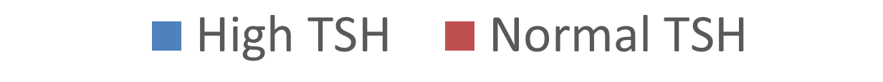
Mean high TSH vs Normal
Notes:
High TSH n=5; Normal TSH n=18

Slide 23
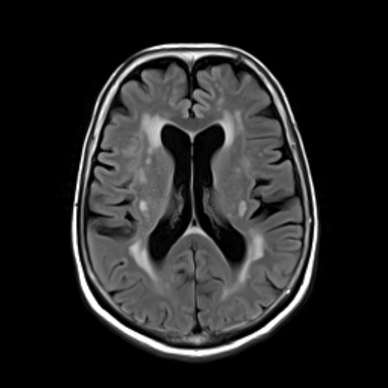
Vascular changes in CN
Notes:
Hyperintensities of subject 055VV; HV 53/M; HT, Diabetic, Dyslipidemia

Slide 24
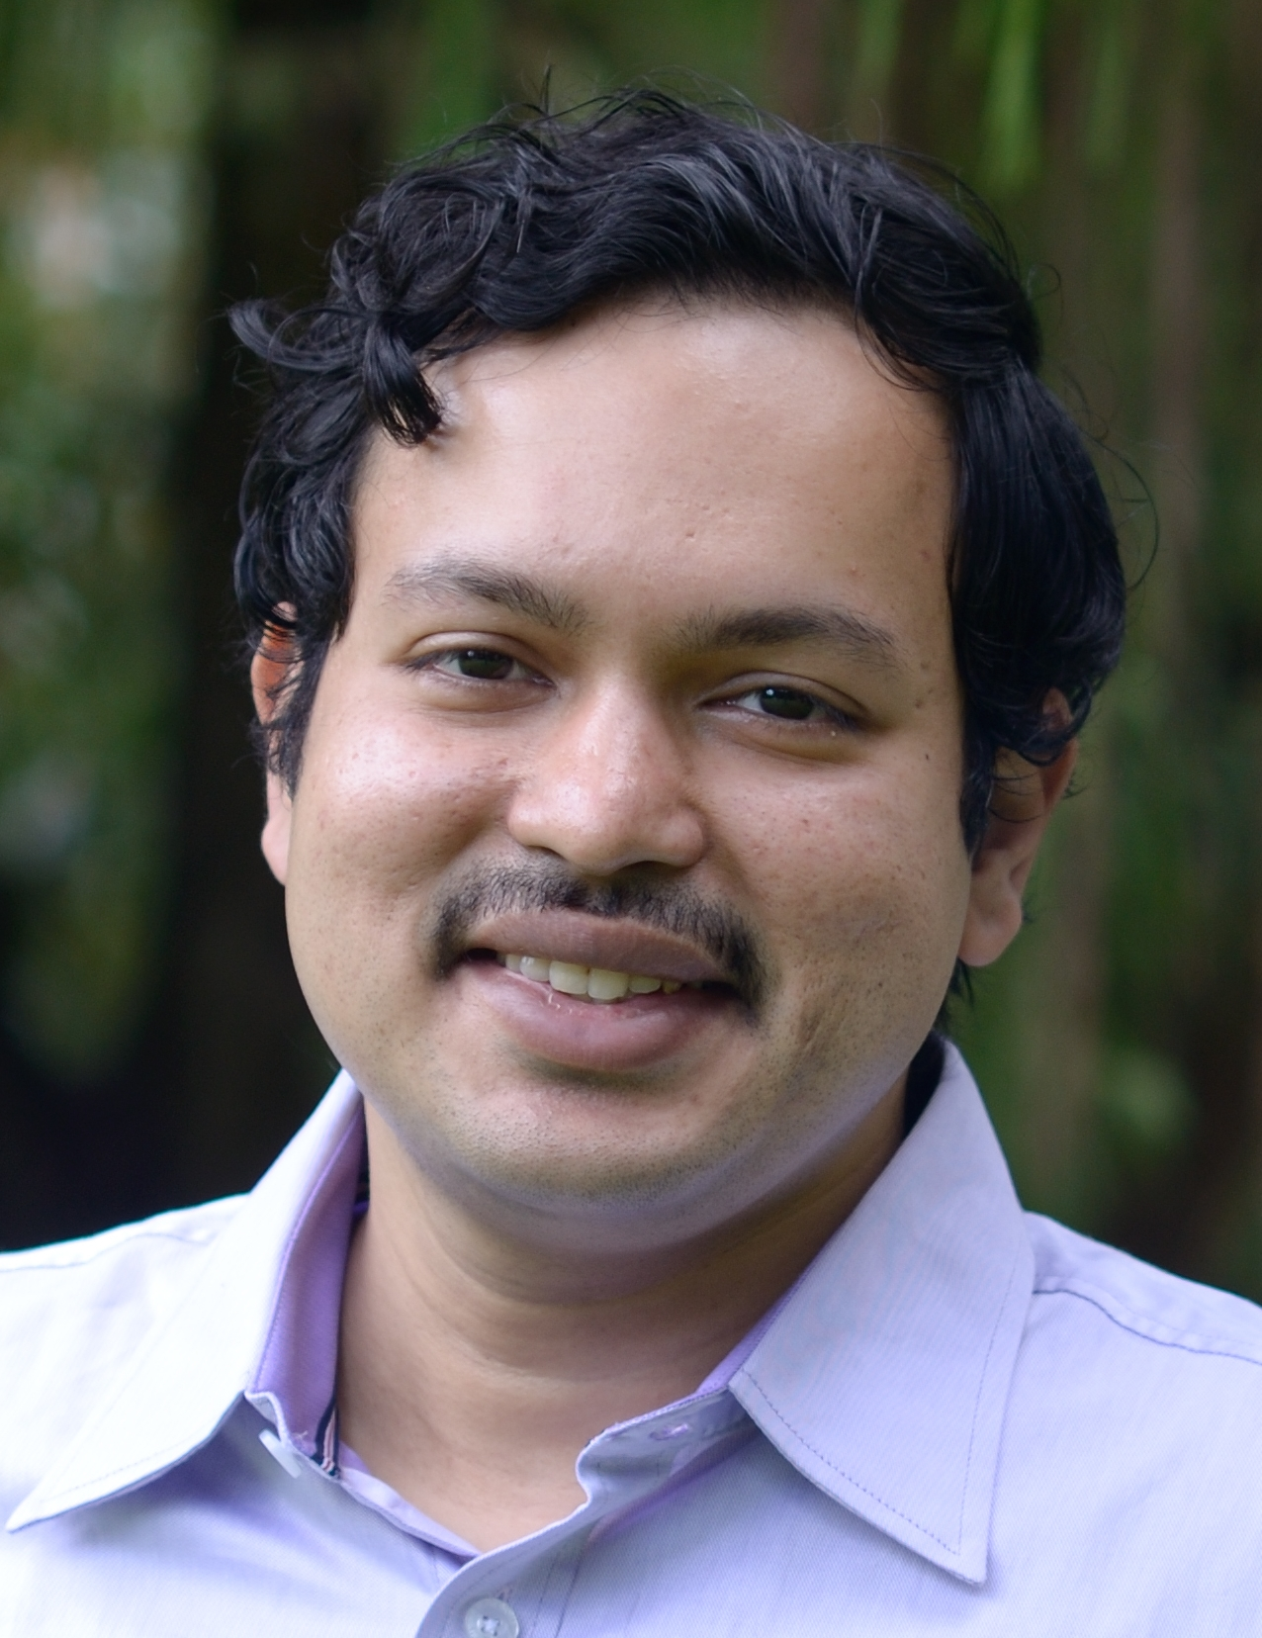
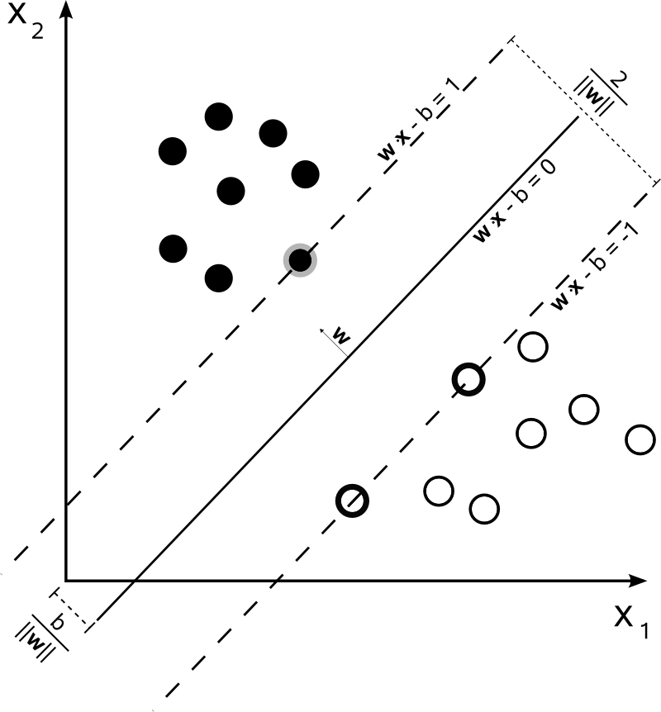
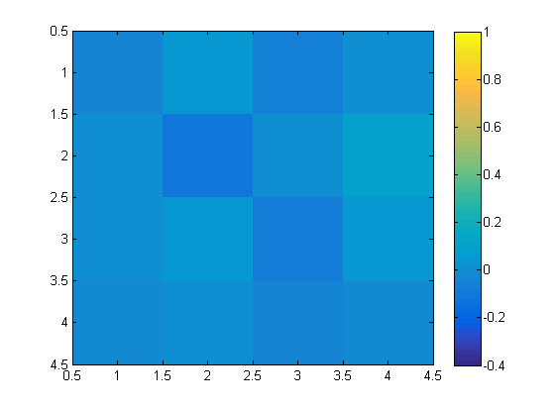
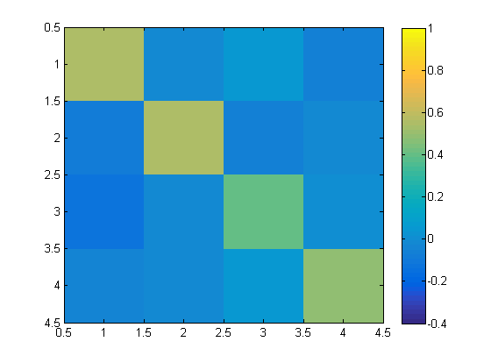
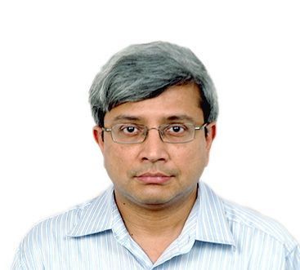
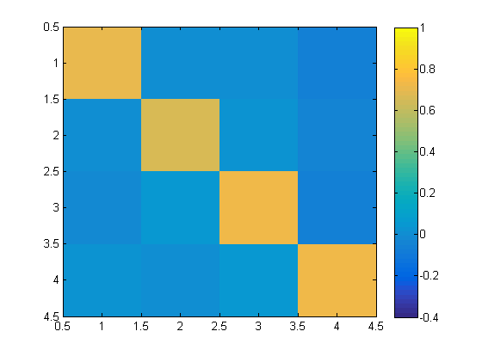
Novel analysis methods and Machine learning: Multivariate linear modeling
AD (55-75 years)
Sridharan Devarajan
Centre for Neuroscience
d
Old (50-70 years)
SVM classified old subjects together with healthy controls
Optimal hyperplane
Young (21-25 years)
SVM provided 100% leave-one-out validation accuracy
Govindan Rangarajan
Professor of Mathematics, IISc
Notes:
We applied multivariate linear modeling to model the timeseries of 4 brain networks measured with functional MRI (left and right executive control network and ventral and dorsal default model network). Preliminary results indicate that machine learning (support vector machine/SVM) based classification is able to distinguish network activity in healthy subjects from AD patients.

Slide 25
THANK YOU

